Slide 1
CTS 6319 Cyber Security: Measurement and Data Analysis
Dr. Elias Bou-Harb
ebouharb@fau.edu EE 503B
Office hours: Mondays 4-6pm

Slide 2
Material
On Canvas
Research Paper 1 (suppl):
Darknet as a Source of Cyber Intelligence: Survey, Taxonomy and
Characterization

Slide 3






The need for Cyber Threat Intelligence (CTI)

Slide 4
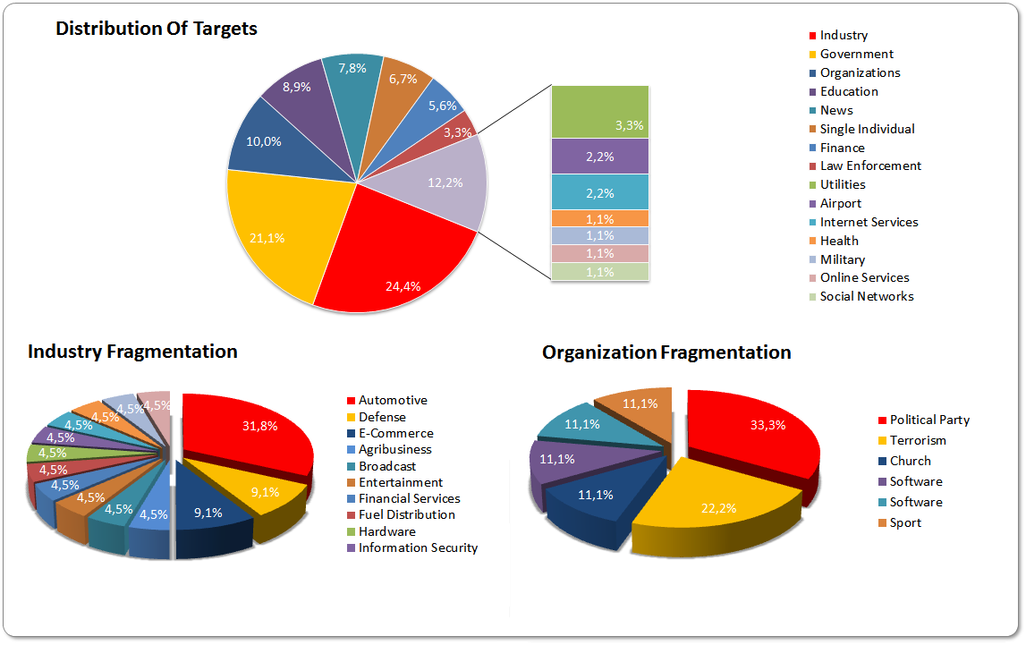
The need for Cyber Threat Intelligence (CTI)

Slide 5
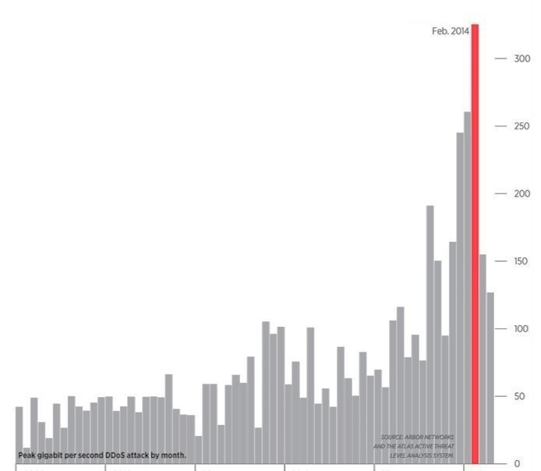
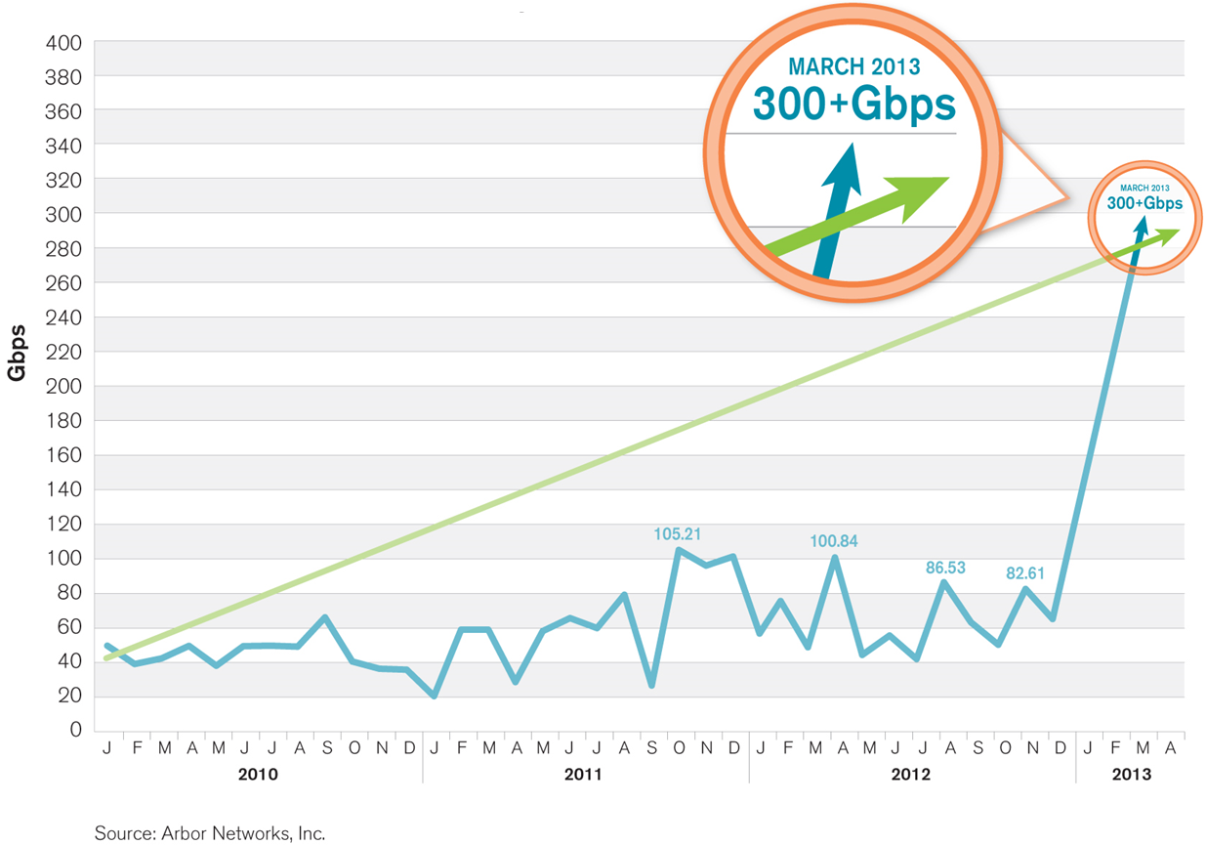
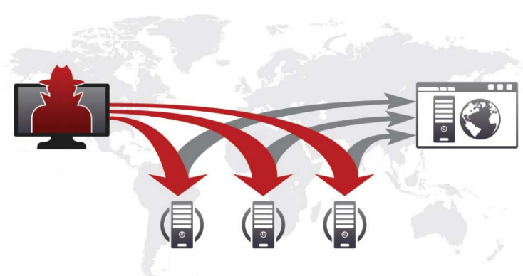
The need for Cyber Threat Intelligence (CTI)
Attacks on cyber-physical systems rose 52% in 2015
The surge of severe DDoS attacks

Slide 6
Motivation
Investigating Internet-scale traffic is an effective approach to generate cyber threat intelligence
Investigate what?
Exploitations
Zero-day attempts
DoS/Scanning
Botnets
Infected Machines
APTs

Slide 7
Method
Analyze traffic from Trap-based monitoring systems
Honeypots
Darknets
IP Grey space
Honeynets
Greynets

Slide 8
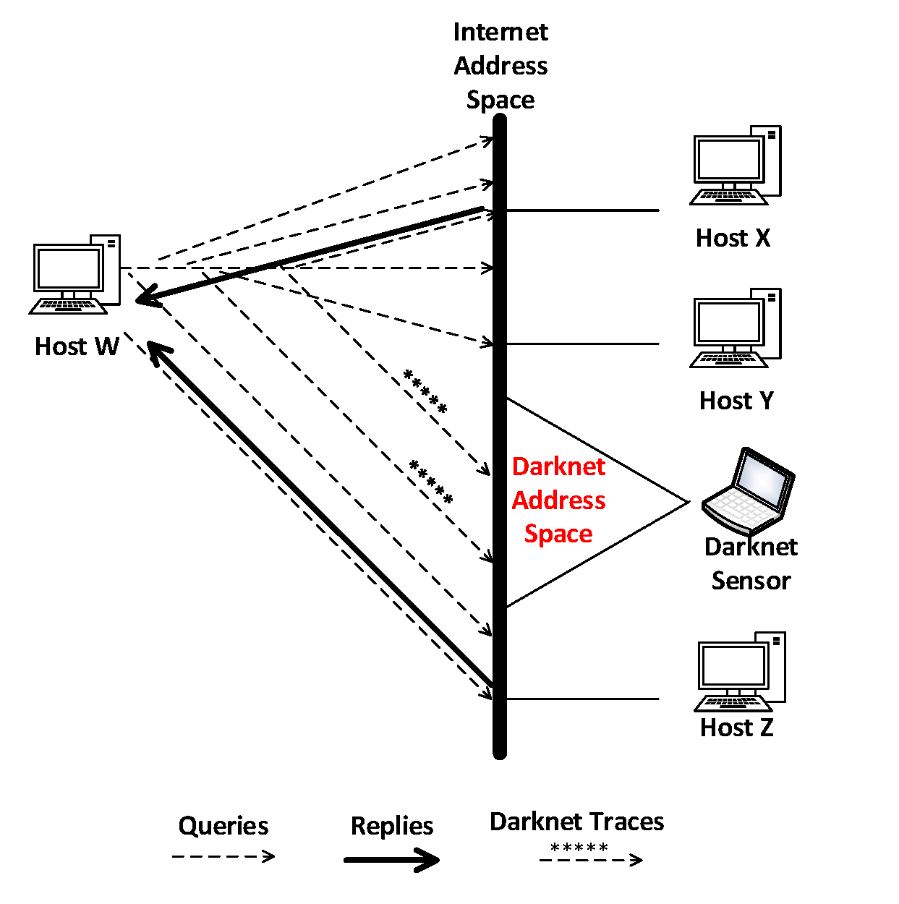
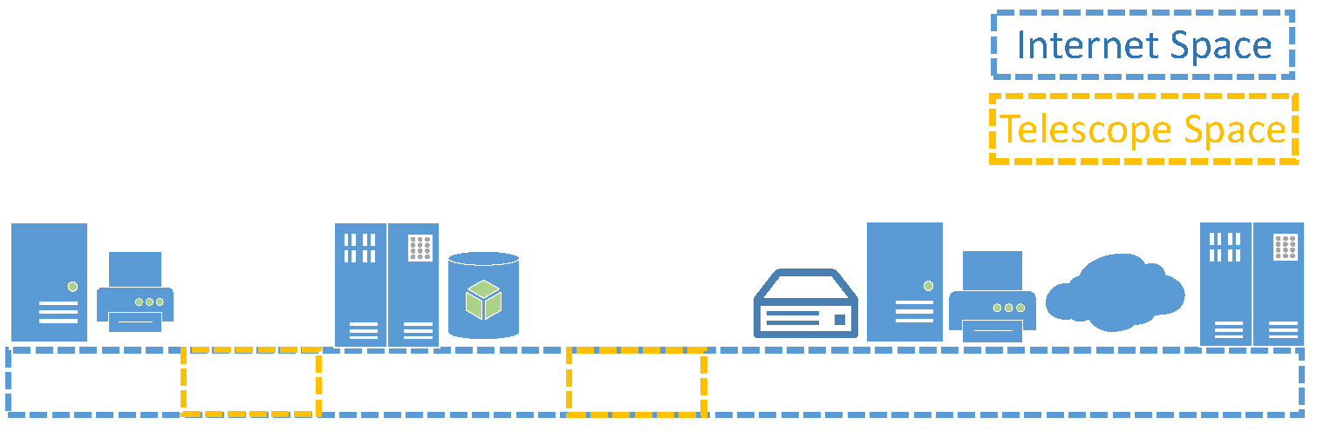
Darknet

Slide 9
Darknet
Purely passive approach
Sensors of dark IP addresses
Dark IP addresses are routable, allocated but unused
Assumptions:
Darknet is indistinguishable from the Internet-space
No legitimate machines have ever been allocated to that space
Attackers have no capability to infer the dark IP space
Rationale:
Any traffic targeting such dark IPs is unsolicited
Not necessary malicious

Slide 10
Darknet: Advantages & Drawbacks
Relatively easy to deploy
Relatively secure (very hard to be inferred/exploited)
Very passive -> No attackers’ real communication

Slide 11
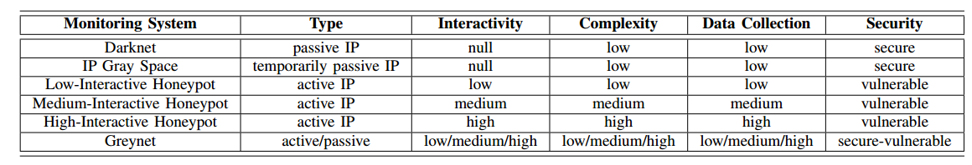
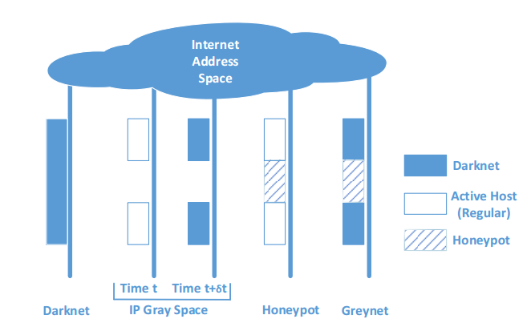
Other Trap Based Systems

Slide 12
Darknet Traffic
Misconfiguration
Scanning
Worms Propagation
DoS
Reflective attacks
Botnet phenomena's
Vulnerabilities exploitation
Recall the needle in the haystack issue

Slide 13
Darknet Misconfiguration Traffic
Unsolicited traffic reaching a darknet
Pollute Darknet with unusable data
Make it harder for CTI algorithms to operate correctly
Typically caused by networking/routing or hardware/software issues
Could also be caused by an improper darknet set-up

Slide 14
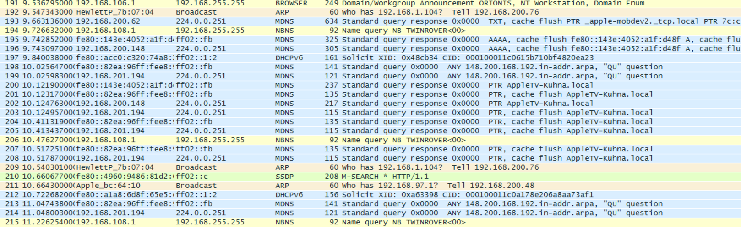
On Fingerprinting Misconfiguration Traffic
Theoretically, an easy task…Turns out very hard in practice

Slide 15
On Fingerprinting Misconfiguration Traffic
Theoretically, an easy task…Turns out very hard in practice
Intuition:
Rareness of misconfiguration packets towards odd services
Scope of access to dark IP addresses
Can we use the above to design an algorithm?

Slide 16
CTS 6319 Cyber Security: Measurement and Data Analysis
Dr. Elias Bou-Harb
ebouharb@fau.edu EE 503B
Office hours: Mondays 4-6pm
http://faculty.eng.fau.edu/ebouharb/

